Slide 1
Microservices - Quick Bite
Ramesh Maharaddi

Slide 2

Software Monolith
One build and deployment unit
One code base
One technology stack (Linux, JVM, Tomcat, Libraries)
Benefits
Simple scaling model for operations
just run multiple copies behind a load balancer

Slide 3


Problems of Software Monoliths
Overloads your IDE and container
Slow down development
Refactoring and builds take hours
Testing in continuous integration takes days
Huge and intimidating code base for developers
Scaling is limited, Running a copy of the whole system is resource-intense
Increase “tight coupling” between components, As codebase increases

Slide 4
Problems of Software Monoliths Cont.…
Re-deploying means halting the whole system
Long Build/Test/Release cycle
Operation is nightmare
Module X is failing who is the owner
New release takes months and long time to add new future

Slide 5
Therefore, Microservices
Definitions of microservices
Microservice architecture - also known as the Microservice - is an architectural style that structures an application as a collection of loosely coupled services, which implement business capabilities
Functional system decomposition into manageable and independently deployable components
Microservice architecture is a method of developing software applications as a suite of independently deployable, small, modular services in which each service runs a unique process and communicates through a well-defined, lightweight mechanism to serve a business goal.

Slide 6
Benefits of Microservices

Slide 7

Small and focused on doing one thing
Size matters (not)
It’s not about lines of code used
Small enough to be handled by a single team

Slide 8
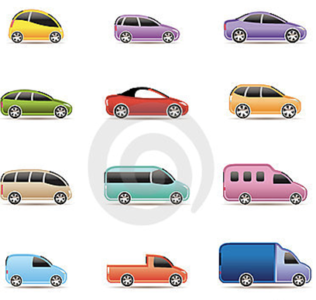
Autonomous
Is a separate entity
Easy to scale as individual component
Make changes to service and deploy without changing anything else
Microservices are autonomous services that take full responsibility for one business capability
Full responsibility includes presentation, API, data storage and business logic.

Slide 9
Key Benefits
Technology Heterogeneity
Resilience
Easy to scale
Rapid Build/Test/Release cycle
Clear ownership and accountability
New release takes minute and short time to add new future

Slide 10
Challenges
ACID properties do not spam multiple services

Slide 11
Frameworks to build micro services
Frameworks
Spring Boot
wildfly swarm
bootique
Dropwizard
Play
Django
There are many framework to build the micro services

Slide 12




Architecture of an Microservices
Dashboards
(Registry, Health)
Clients
API Gateway
Registry / Discovery
Circuit Breaker
Config Server
Database
Micro Service C
Micro Service A
Micro Service B
Load Balanced
Load Balanced
Database
Micro Service D
Database
Database
Micro Service E
Database
Security
Routing
Load Balancing

Slide 13
Components
Centralized configuration
Service registration and Service discovery
Client side load balancing
Circuit Breaker
API Gateways

Slide 14
Yelp, Airbnb, Stripe and Netflix.
http://www.kennybastani.com/2015/07/spring-cloud-docker-microservices.html
http://bits-and-kites.blogspot.in/2014/10/spring-cloud-eureka-server.html
http://wildfly-swarm.io/generator/
https://technologyconversations.com/2015/09/08/service-discovery-zookeeper-vs-etcd-vs-consul/
https://dzone.com/articles/service-discovery-in-a-microservices-architecture-1
http://www.baeldung.com/spring-cloud-netflix-eureka
https://dzone.com/articles/spring-cloud-netflix-load-balancer-with-ribbonfeig
https://fernandoabcampos.wordpress.com/category/enableeurekaserver/
https://www.nginx.com/blog/microservices-api-gateways-part-1-why-an-api-gateway/

Slide 15
Centralized configuration
Problem
Solution
Properties are bundled with application
Externalizing configuration git/svn/bitbucket
Config Server
Micro Service
Micro Service
Micro Service
Database
Micro Service
Micro Service
Micro Service
Database
Back

Slide 16
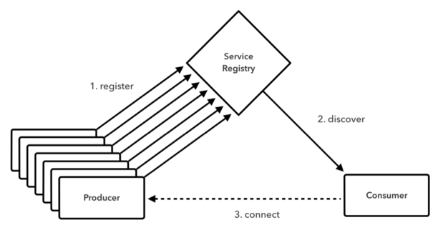
Service registration and Service discovery
What is service discovery?
Service discovery is the automatic detection of services. In order to make a request, your code needs to know the network location (IP address and port) of a service instance.
Why service discovery?
In a modern, cloud-based application, this is a much more difficult to find the service instances which have dynamically assigned network locations.
Service instances changes dynamically because of auto-scaling, failures, and upgrades
Micro Services
Micro Service
Back

Slide 17
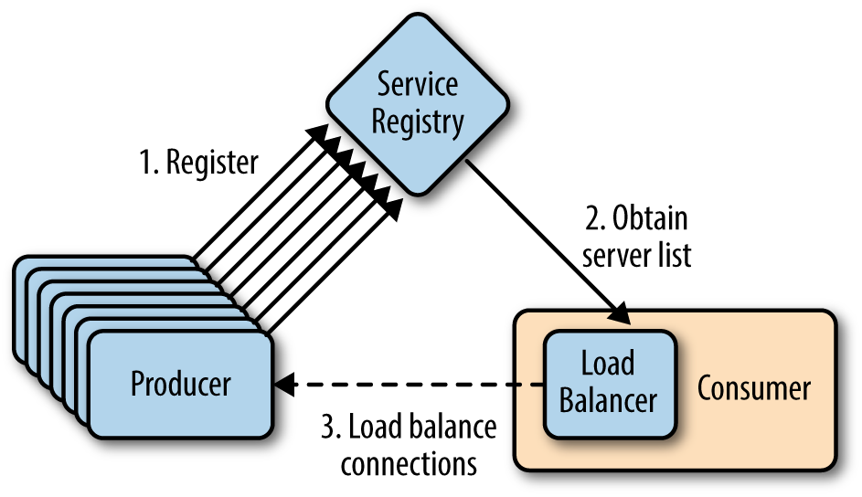
Load Balancing
Why Load Balancer?
Load balancing improves the distribution of workloads across multiple resources.
1. Server side load balance
2. Client side load balancer
Why client side load balancer?
One reason for using client-side load balancer can be performance.
With client side balancer you can directly contact desired service with one network hop
Micro Services
Micro Service
Back

Slide 18
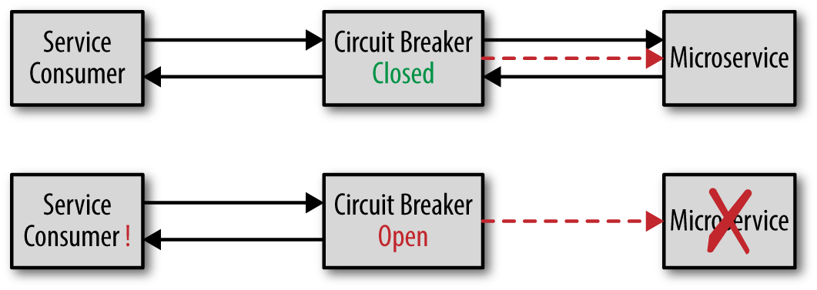
Circuit Breaker
Circuit breaker is a design pattern used in modern software development.
Circuit Breaker pattern to gracefully degrade functionality when a method call fails
Use of the Circuit Breaker pattern can allow a microservice to continue operating when a related service fails.
When circuit is open it will call the fallback method to return gracefully message
Back

Slide 19
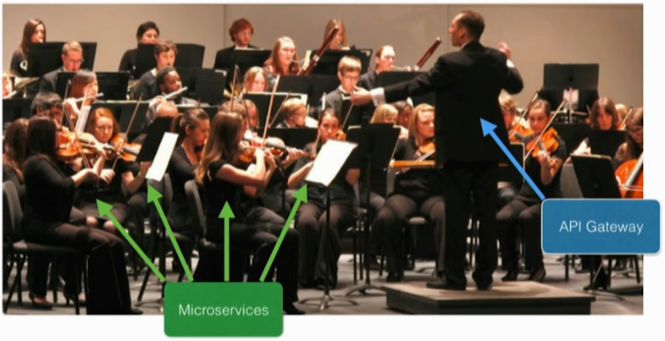
API Gateways
Why API Gateway?
How do the clients of a Micro services-based application access the individual services?
An API gateway that is the single entry point for all clients.
Centralized Middleware Functionality
Authentication, Security, Traffic Control, Logging
Micro Service
API Gateway
Micro Service
Micro Service

Slide 20
Tools or API’s
Service registration and Service discovery | Eureka, Cloud Foundry, Zookeeper, Consul
Load Balancing | Ribbon, Feign - Load Balancer using Eureka, SmartStack
Circuit Breaker | Hystrix, Turbine, Failsafe and vertx
Centralized configuration | Config Server, Vault Configuration, Zookeeper Configuration, Consul Configuration
API Gateways | Apigee, ZULL

Slide 21
Q&A

